Slide 1
Presentation on “Search Locations Safely and Accurately: A Location Privacy Protection Algorithm with Accurate Service”
Presented by
Md. Abdul Mutalib
ID: 190303020001
Semester: 9th
Dept: CSE

Slide 2
Presentation Outline
Introduction
Privacy leakage of LSS
The Solution for Location Privacy
The Proposed Algorithm
How Algorithm works
Success of the Algorithm

Slide 3
Introduction
We use Location Bases Service (LBS) in our everyday life. User can get service at any time and anywhere. For example, Google map.
However, location information is consistently sent to service providers without protection when users query Location Base Services (LBSs), allowing providers to collect information from all users.

Slide 4
Privacy leakage of LSS
The collected information may expose users to customized advertisement
Location information may be leaked to adversaries with criminal intents.
Location information even be sold to third parties.

Slide 5
What’s The Solution for Location privacy issue ?
WE introduce an innovative algorithm for the problem. Our algorithm will provide –
Accurate LSSs
Location Privacy Protection
Zero Quality Loss

Slide 6
The proposed algorithm contribution:
To the best of our knowledge, this is the first algorithm that provides protection for Location Searching Services (LSSs) without quality loss.
It is the first algorithm that provide accurate services and location privacy protection simultaneously.

Slide 7
How the Algorithms works ???
When users launches an LSS query –
The proposed algorithm randomly chooses three locations (assisted locations) instead of the real location to query services.
If queries of assisted locations are successful, the user will get accurate results for the assisted location.

Slide 8
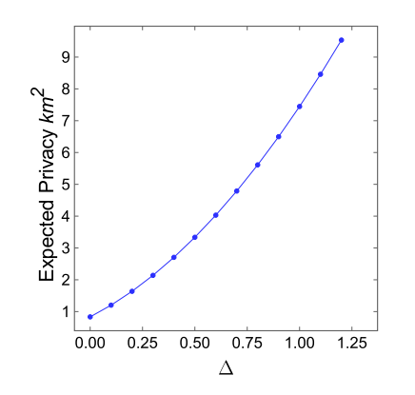
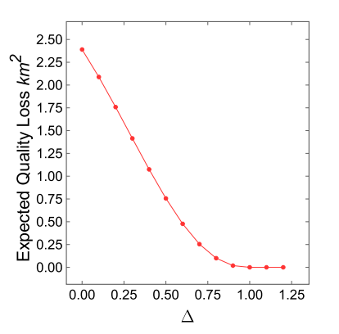

The Success of Proposed Algorithm
Figure (a,b) shows the result for expected privacy and Quality Loss
As shown Fig (a), when $∆$increases, the expected privacy increases exponentially.
And in Fig(b) shows that, Quality Loss (QL) decreases exponentially as $∆$ increases.
Fig. a
Fig. b

Slide 9
Thank You

